Slide 1
Meeting 18/05/2020
Naudé Conradie
19673418

Slide 2
Monte Carlo Simulation
Remove only specific number of elements or range of elements
Check that prevents more runs than possible being requested
Baseline check
Performs poorly as expected

Slide 3
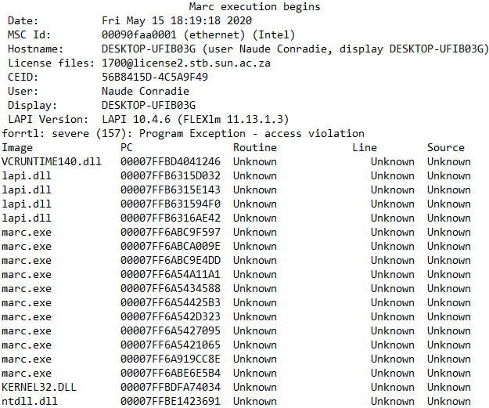
New Error

Slide 4
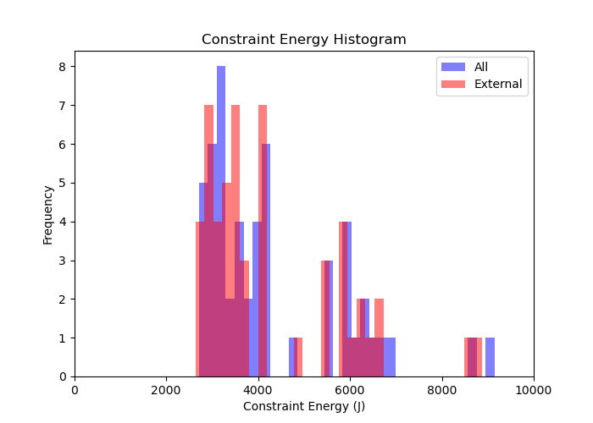
Histograms

Slide 5
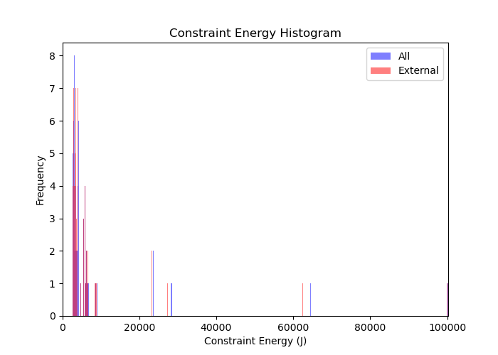
Histograms

Slide 6
Code
Docstrings are implemented
Function and class arguments formatted properly
To do:
Yield
Shifting calculations to the end of the process
Unit tests
Templates
Where in Cook book?

Slide 7
Admin
Working through the Constraint Energy Minimization paper
Forgot to request SSD
Will do so after the meeting

